Slide 1
What is your Stakeholder experience? A practical guide and tips on starting your ESG journey
A business that makes only money is a poor business
Henry Ford

Slide 2
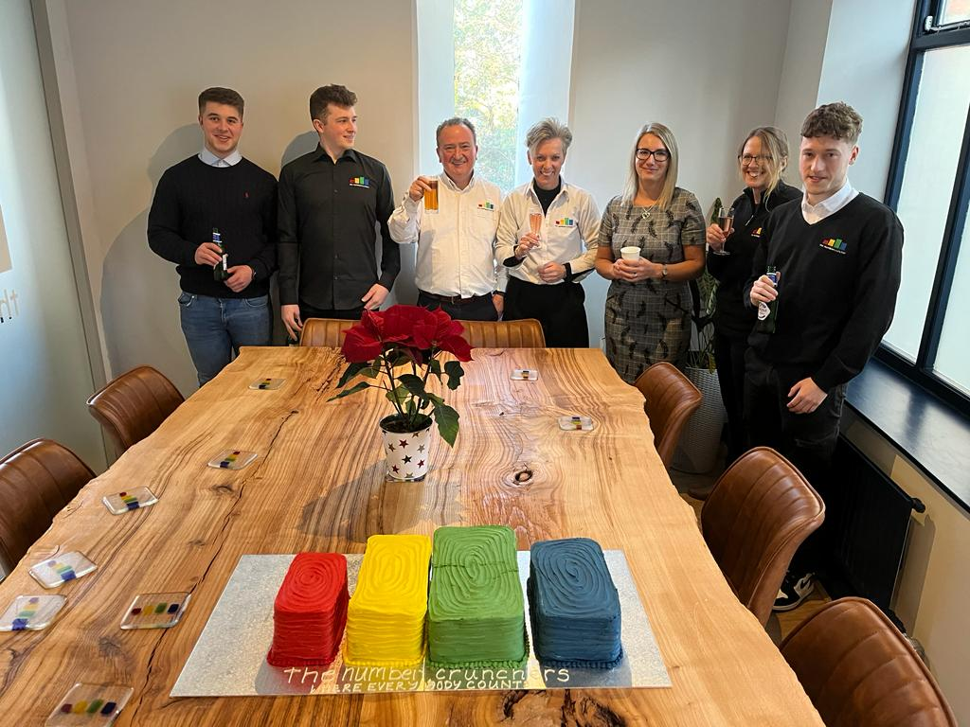
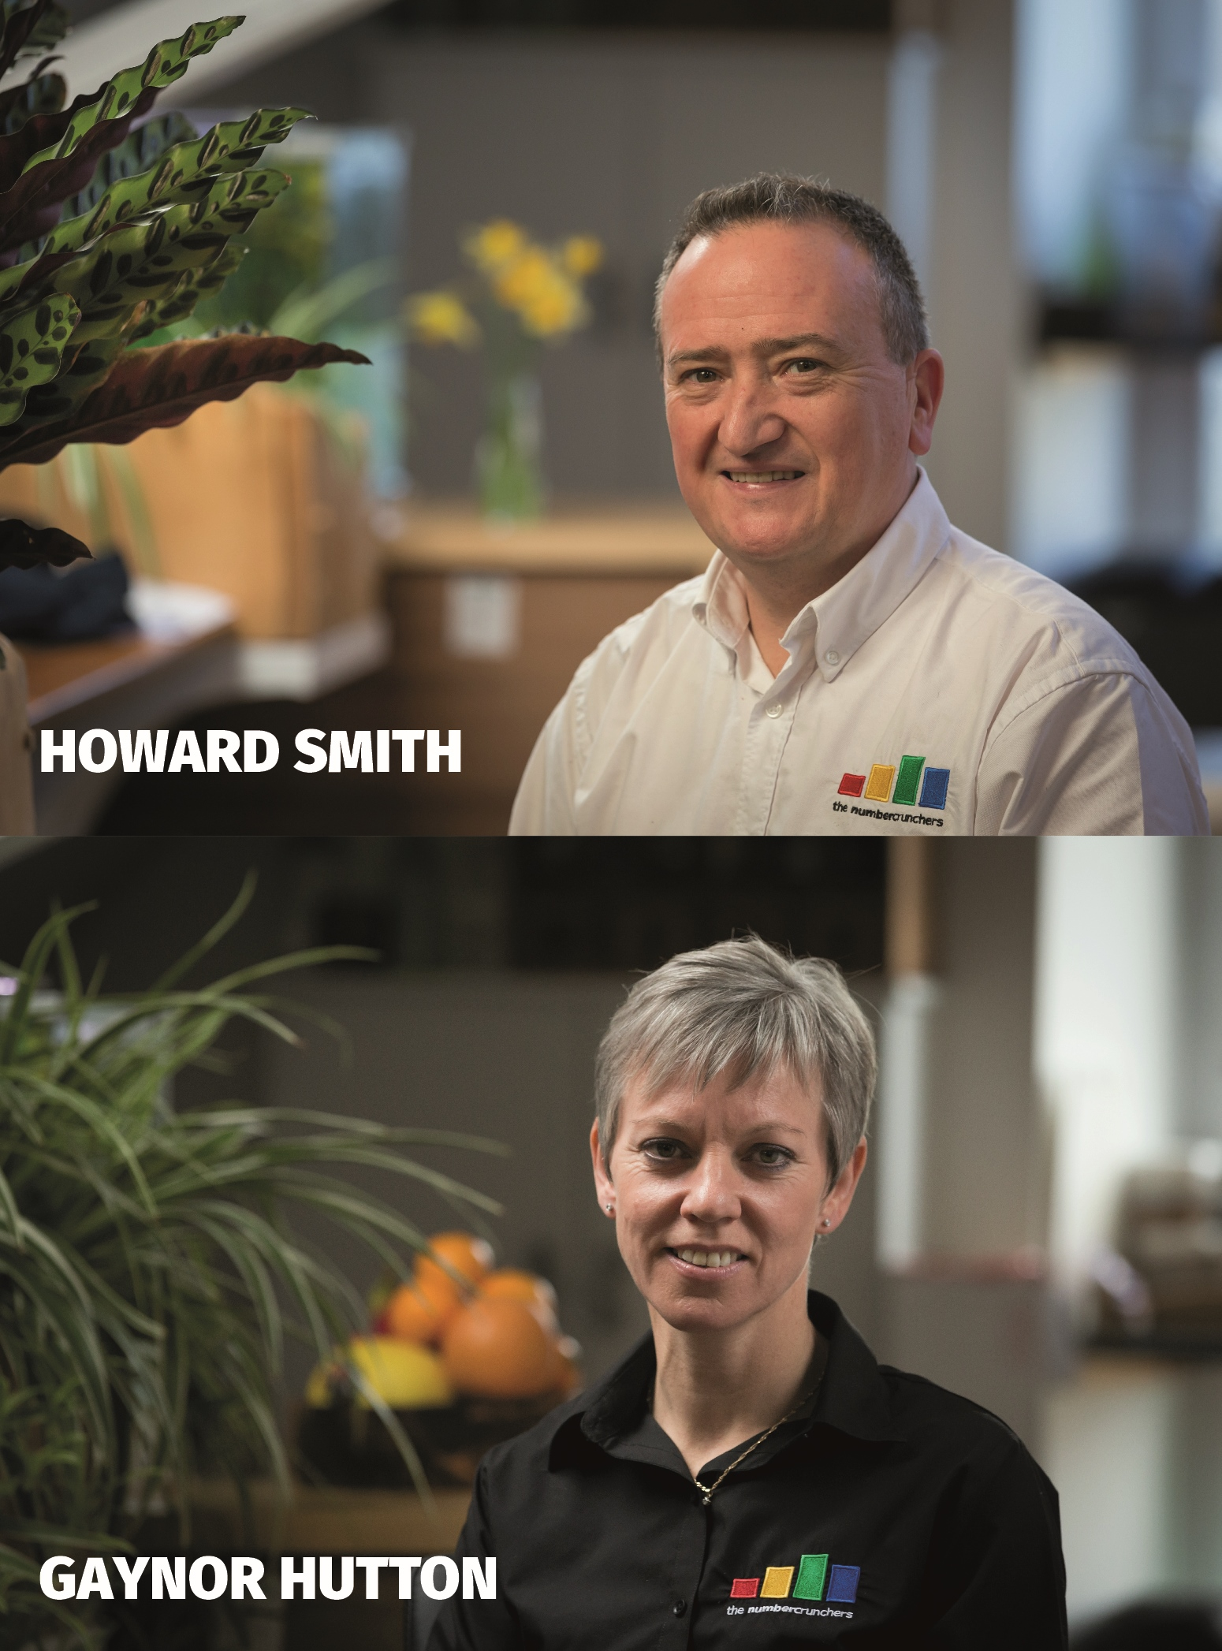
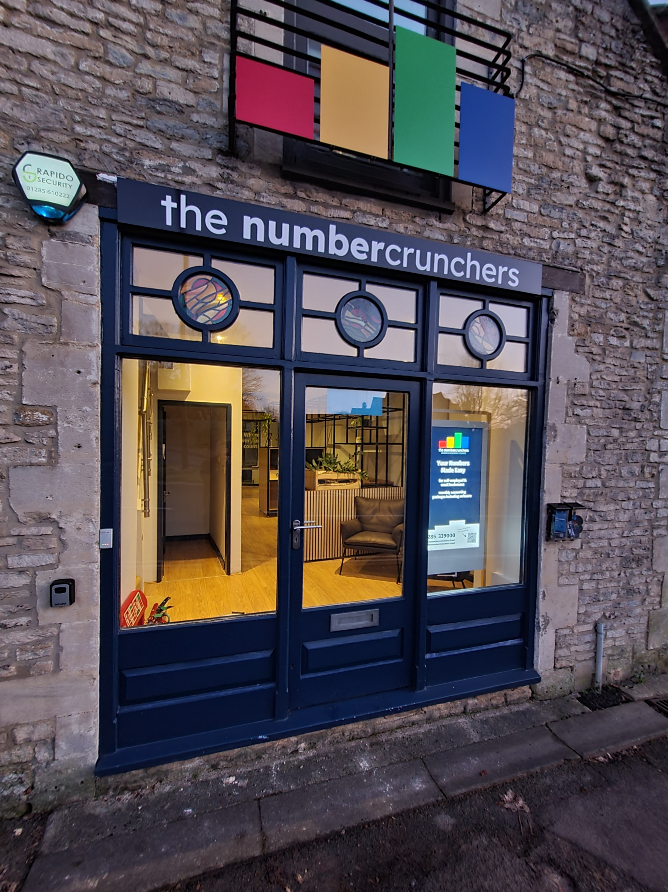
Started in 2014

Slide 3
Little Things Can Have Big Impact

Slide 4
Identify your stakeholders
Your business activities will have a ripple effect on all things people and planet
You
Customers
Communities
Staff
Suppliers
Planet
Shareholders
Investors
Govt /Society

Slide 5
Stakeholder Economics with a Donut Twist!
Planet
Bad for the planet
Good for the planet
THE STAKEHOLDERS
The Planet Limits
You, Employees, Shareholders
Customers, Suppliers, Investors
Communities, Planet, Government & Society
Social Foundation
Basic Needs
Comfort Zone
Excess Zone
STAKEHOLDER PILLARS
Bad for people
Good for people
Principles
People
Planet
Prosperity
THE HAPPY ZONE
WHAT ACTION WILL YOU TAKE?
Do nothing
Do no harm
Do what pays
Do your fair share
Be generous

Slide 6
Change your search engine
Search the web to plant trees
IMPACT LEVEL
2
EFFORT LEVEL
1
RIPPLE EFFECT
You
Customers
Communities
Staff
Suppliers
Planet
Shareholders
Investors
Govt /Society
OVERALL SCORE 2 / 1 = 1 x 3 = 3

Slide 7
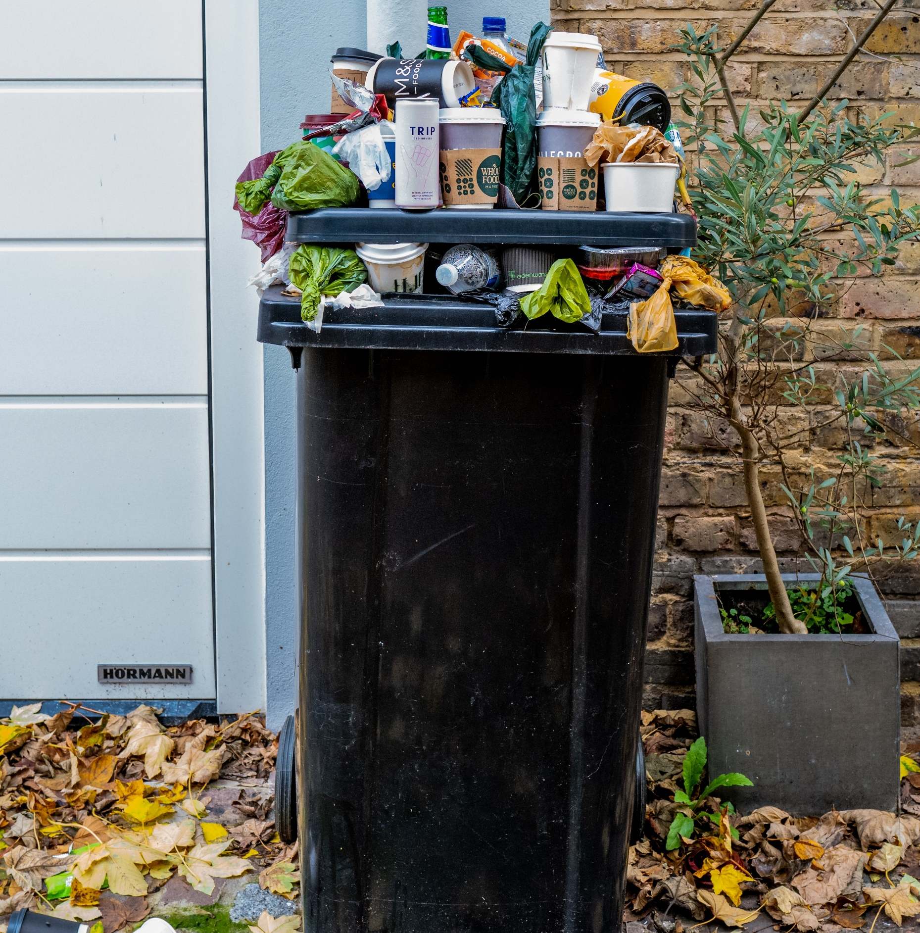
Look at your waste
Take a really good look at what you throw out and where it goes
IMPACT LEVEL
8
EFFORT LEVEL
2
RIPPLE EFFECT
You
Customers
Communities
Staff
Suppliers
Planet
Shareholders
Investors
Govt /Society
OVERALL SCORE 8 / 2 = 4 x 4 = 16

Slide 8
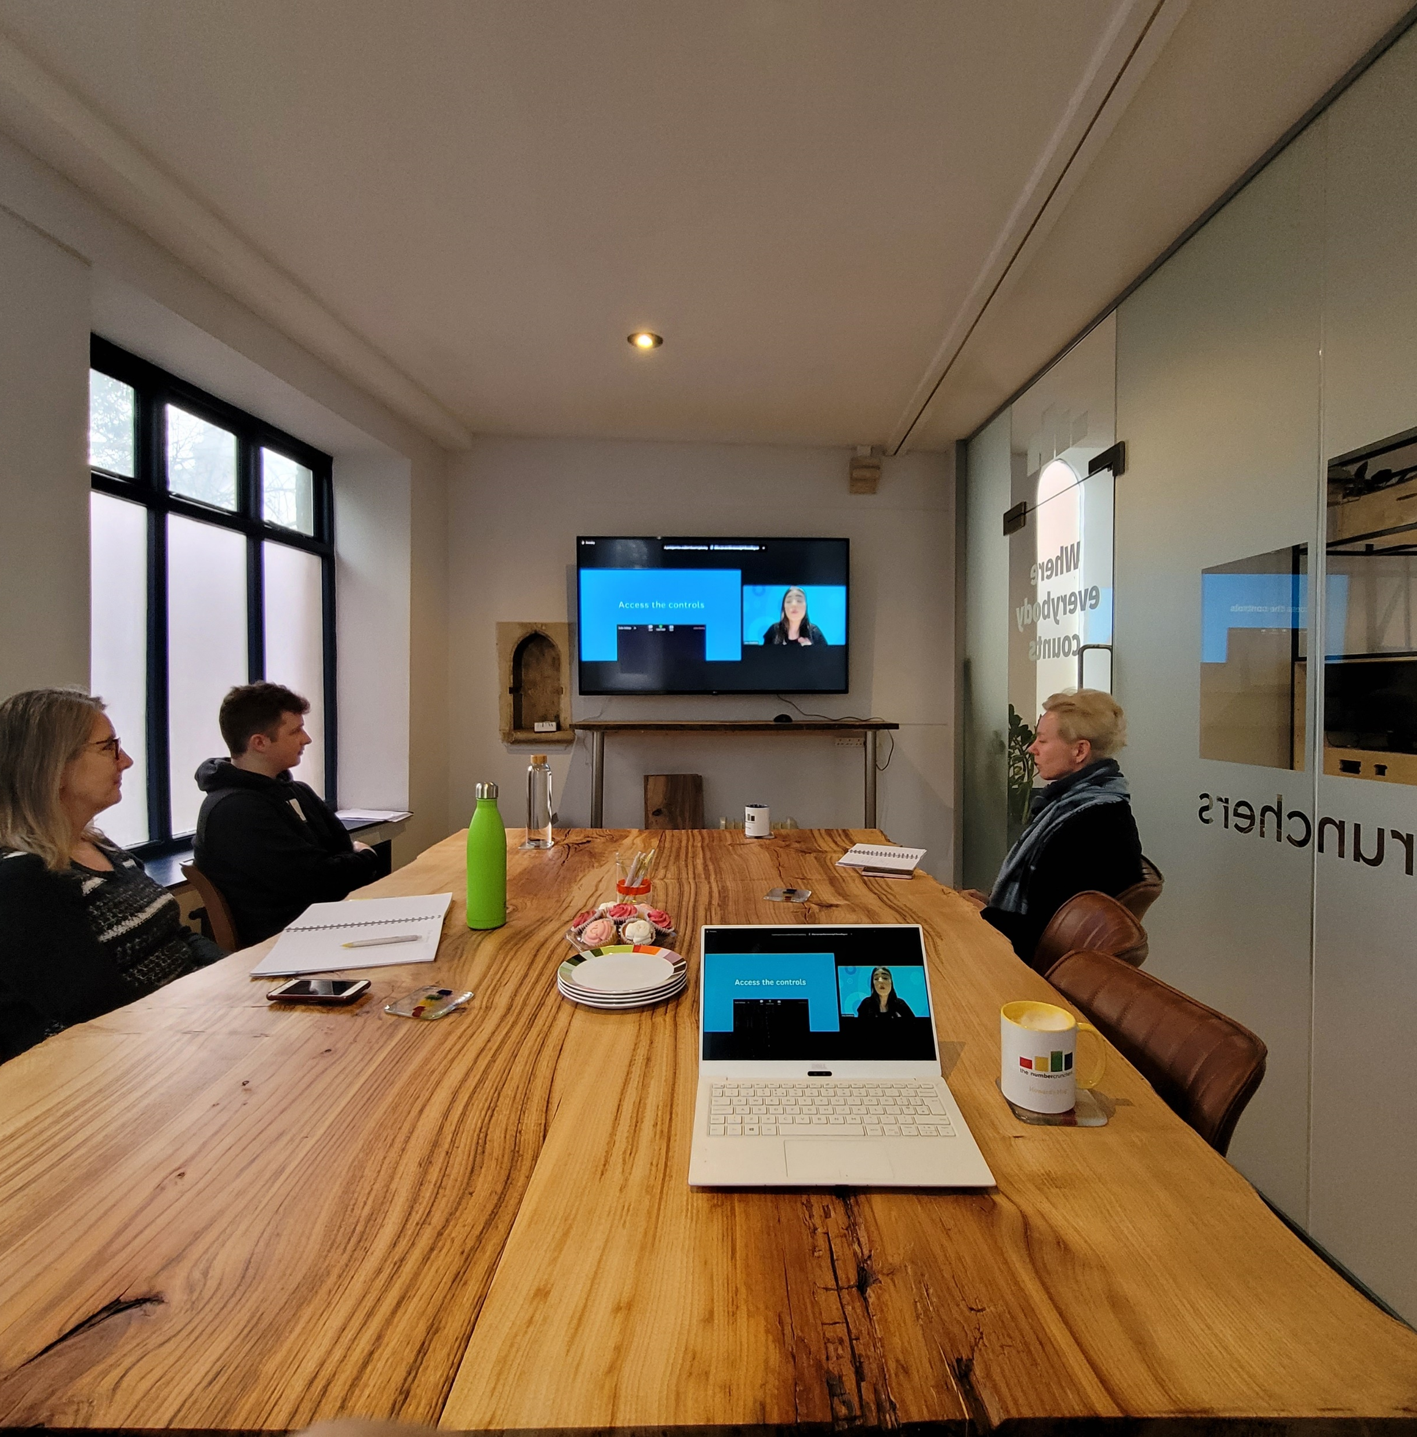
Stop Printing
Think before you print, make sure your staff do too.
IMPACT LEVEL
4
EFFORT LEVEL
2
RIPPLE EFFECT
You
Customers
Communities
Staff
Suppliers
Planet
Shareholders
Investors
Govt /Society
OVERALL SCORE 4 / 2 = 2 x 8 = 16

Slide 9
Move your pension
Watch out for passive investing in fossil fuels.
IMPACT LEVEL
10
EFFORT LEVEL
5
RIPPLE EFFECT
You
Customers
Communities
Staff
Suppliers
Planet
Shareholders
Investors
Govt /Society
OVERALL SCORE 10 / 5 = 2 x 7 = 14

Slide 10
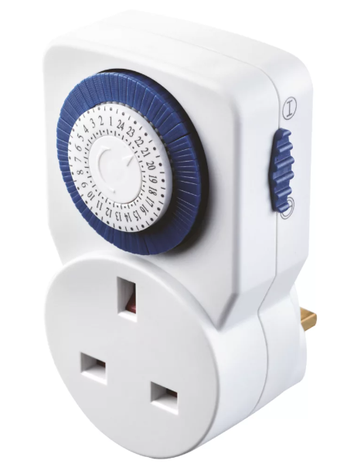
Timer Plugs
Stop unnecessary power consumption.
IMPACT LEVEL
3
EFFORT LEVEL
1
RIPPLE EFFECT
You
Customers
Communities
Staff
Suppliers
Planet
Shareholders
Investors
Govt /Society
OVERALL SCORE 3 / 1 = 3 x 6 = 18

Slide 11
Pay Suppliers Quickly
The question is what makes a good customer?
IMPACT LEVEL
6
EFFORT LEVEL
2
RIPPLE EFFECT
You
Customers
Communities
Staff
Suppliers
Planet
Shareholders
Investors
Govt /Society
OVERALL SCORE 6 / 2 = 3 x 6 = 18

Slide 12
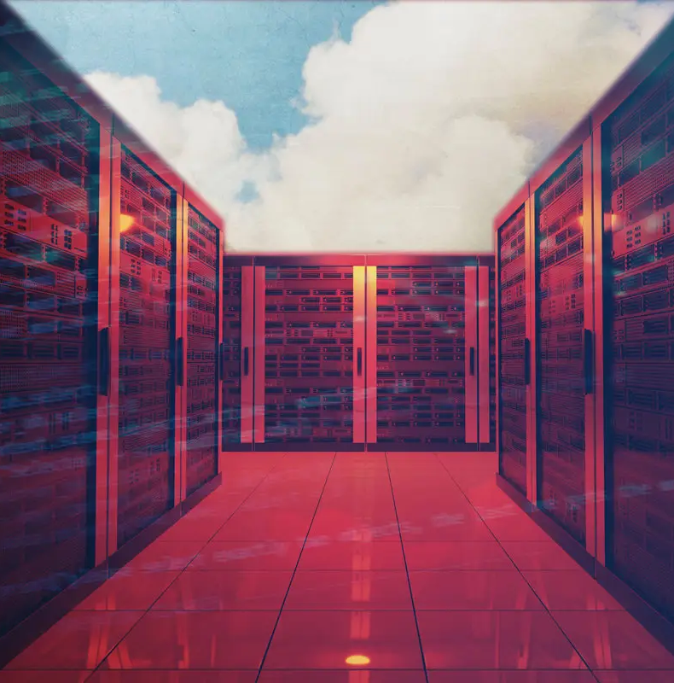
Delete your data
7 years for financial records and image library repeats
IMPACT LEVEL
8
EFFORT LEVEL
4
Potentially 3.2% of global consumption by 2025
RIPPLE EFFECT
You
Customers
Communities
Staff
Suppliers
Planet
Shareholders
Investors
Govt /Society
OVERALL SCORE 8 / 4 = 2 x 8 = 16

Slide 13
Review your supply chain
What are their policies? Who do you want to do business with?
IMPACT LEVEL
6
EFFORT LEVEL
2
RIPPLE EFFECT
You
Customers
Communities
Staff
Suppliers
Planet
Shareholders
Investors
Govt /Society
OVERALL SCORE 6 / 2 = 3 x 8 = 24

Slide 14
Gift and Donate
Give what you can, especially when your cup is full
IMPACT LEVEL
10
EFFORT LEVEL
1
RIPPLE EFFECT
You
Customers
Communities
Staff
Suppliers
Planet
Shareholders
Investors
Govt /Society
OVERALL SCORE 10 / 1 = 10 x 9 = 90

Slide 15
Lead by Example
You’re the boss – define what is acceptable in your workplace
IMPACT LEVEL
10
EFFORT LEVEL
2
RIPPLE EFFECT
You
Customers
Communities
Staff
Suppliers
Planet
Shareholders
Investors
Govt /Society
OVERALL SCORE 10 / 2 = 5 x 9 = 45

Slide 16
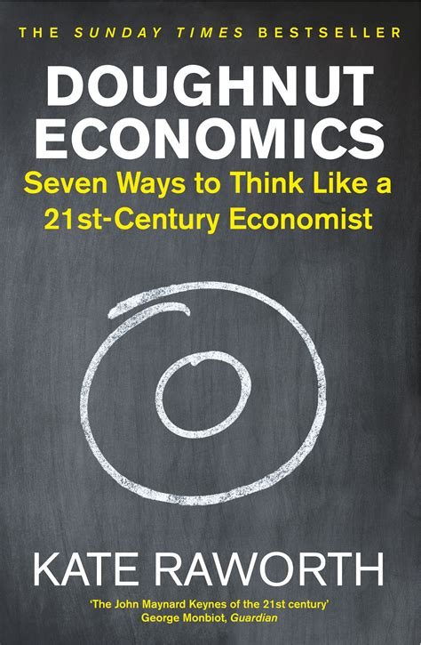
3 good reads

Slide 17
A term for allowing low value decisions in a commercial veil so as to excuse a level of bad or immoral behaviour
‘That’s just business’
Let’s change this meaning together!

